Slide 1
Crypto-Meet Up
BY :
N161299
N160564
N160476
N160179
N160098
N160219

Slide 2
CONTENTS
Abstract
EXISTING SYSTEM
PROPOSED SYSTEM
SYSTEM REQUIREMENTS
Technologies
PYTHON LIBRARIES
STEPS TO IMPLEMENT THE PROJECT
OUTPUT

Slide 3
ABSTRACT
In present days, information has become the most powerful commodity. Communication online or through wireless networks has become an integral part of our lives. The data being transmitted is prone to various passive and active attacks. Daily on an average more than 50% of our messages are being spied by attackers. We must need an efficient and secure protocol to surpass these issues. Double Ratchet Mechanism is most fitting to achieve privacy. Monopolistic messaging giants like WhatsApp, Signal, Facebook Messenger are currently using this mechanism for message privacy. It can be used as a part of cryptographic protocol. The Signal Protocol is a non-federated cryptographic protocol that can be used to provide end-to-end encryption for instant messaging conversations. End-to-End encryption is a system of communication where only the communicating users can read the messages. In Double Ratchet Mechanism Every message sent or received is encrypted with a unique message key. Our Chat room need a network to transfer messages between users. This network is developed by using Sockets. So from this project we are hoping to create a secure messaging chat platform.

Slide 5
EXISTING SYSTEM
In present system, a server is used to connect two people to transfer messages between them. Here the security of messages is provided by using general encryption techniques.
Drawbacks of Existing System:
-It doesn’t provide enough security.
-It lacks Confidentiality, Integrity and Authenticity.
-It doesn’t provide end-to-end encryption.

Slide 6
Proposed System
This project aims to provide stronger security by using some powerful algorithms like Double-Ratchet.
Advantages of Proposing System:
- It provides end-to-end encryption.
- It achieves CIA triad (Confidentiality, Integrity and
Authenticity).
- It provides Unique key to encrypt each message.

Slide 7
Hardware and Software Requirements
Hardware requirements:
- PC with minimum 4GB RAM
- i3 with 64 bit processor.
Software requirements:
- Python IDLE 3.9.0
- Windows 10.
- PIP tool 9.0.1

Slide 8
TECHNOLOGIES
Python is the programming language that we use to develop this project.
The main domain that we chosen to develop this project is Cryptography.
The reason we choose the python language is it is a platform independent and it has many inbuilt packages to implement this project.

Slide 9
Python Libraries
Cryptography
Pycryptodome
Base64
Socket
Smtplib
Threading

Slide 10
Cryptography:
- It is a package which provides cryptographic recipes and primitives to Python developers. Cryptography is broadly divided into two levels.
- One with safe cryptographic recipes that require little to no configuration choices.
Socket
- It is available on all modern Unix systems, Windows, MacOS.
- The socket() function returns a socket object whose methods implement the various socket system calls.
-read() and write() operations on Python files are used.

Slide 11
Pycryptodome
- PyCryptodome is a self-contained Python package of low-level cryptographic primitives.
- All modules are installed under the Crypto package.
- Authenticated encryption modes (GCM, CCM, EAX, SIV, OCB)Accelerated AES on Intel platforms via AES-NI scrypt and HKDF.
Base64
- It was used to Converts the plain text to Base64 format.

Slide 12
Smptlib
- The smtplib module defines an SMTP client session object that can be used to send mail to any Internet machine with an SMTP or ESMTP listener daemon.
- class smtplib.SMTP(host='', port=0, local_hostname=None, [timeout, ]source_address=None.
Serialization and Unserialization
- “Serialization” is the process whereby a Python object(Key) hierarchy is converted into a byte stream, and “Unserialization” is the inverse operation, whereby a byte stream (from a binary file or bytes-like object) is converted back into an object hierarchy.

Slide 13

Double Ratchet Algorithm:
Double Ratchet is used by the biggest platforms in the field, such as Signal, Facebook Messenger, Whats App and Matrix in order to provide E2E encryption for their instant messages. To clear that up, as I was wondering about this myself, this means that each message is encrypted on the client by each unique key.
But how the unique keys are generated …

Slide 14
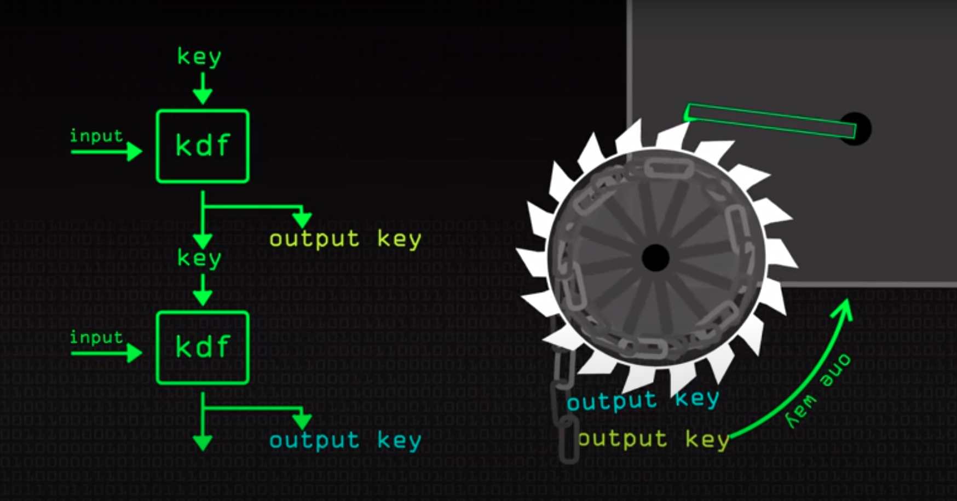
Ratchet ...

Slide 15
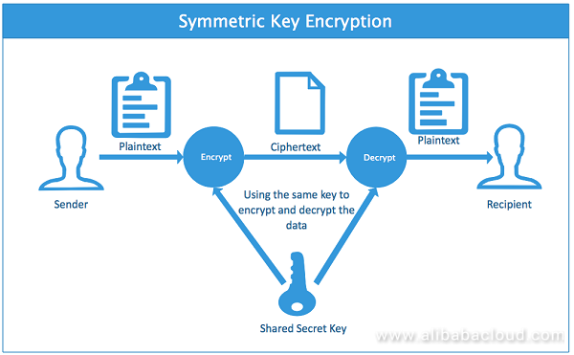

Slide 16
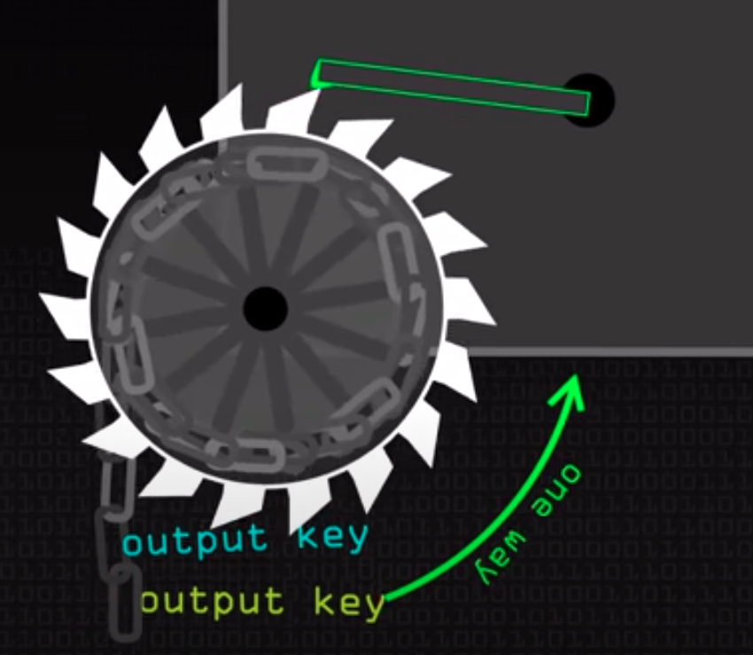
Alice Bob

Slide 17
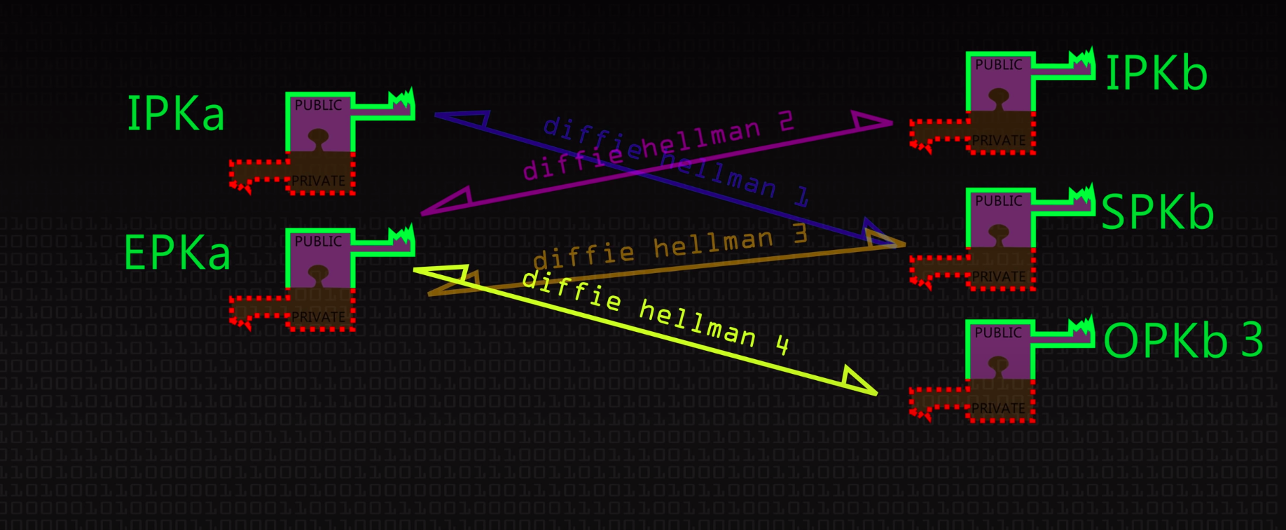
But the Problem with Attacks ...!
How to exchange the Secret key between Alice and Bob ...?
Key exchange using Extended Triple Diffie-Hellman:
The Extended Triple Diffie-Hellman (or X3DH) algorithm is used to establish the initial shared secret key between Alice and Bob, based on their public keys and using a server.

Slide 18
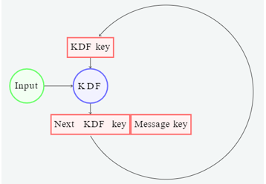
Calculating the following four secret outputs, using Diffie-Hellman:
DH1 = DH(IK_a, SPK_b)
DH2 = DH(EK_a, IK_b)
DH3 = DH(EK_a, SPK_b)
DH4 = DH(EK_a, OPK_b)
Symmetric Ratchet:
On the initial step, the KDF function is supplied with a secret key and some input data, which can be a constant. The output of the KDF is another secret key. This new key is split into two parts: The next KDF key and the message key. This is a turn of the “ratchet”: The internal state of the ratchet (the KDF key) is changed and a new message key is created.

Slide 19

The biggest Question is ,
why we need Two ratchets on Both Alice and Bob side , while one ratchet will generate the same keys in both the sides ?

Slide 20
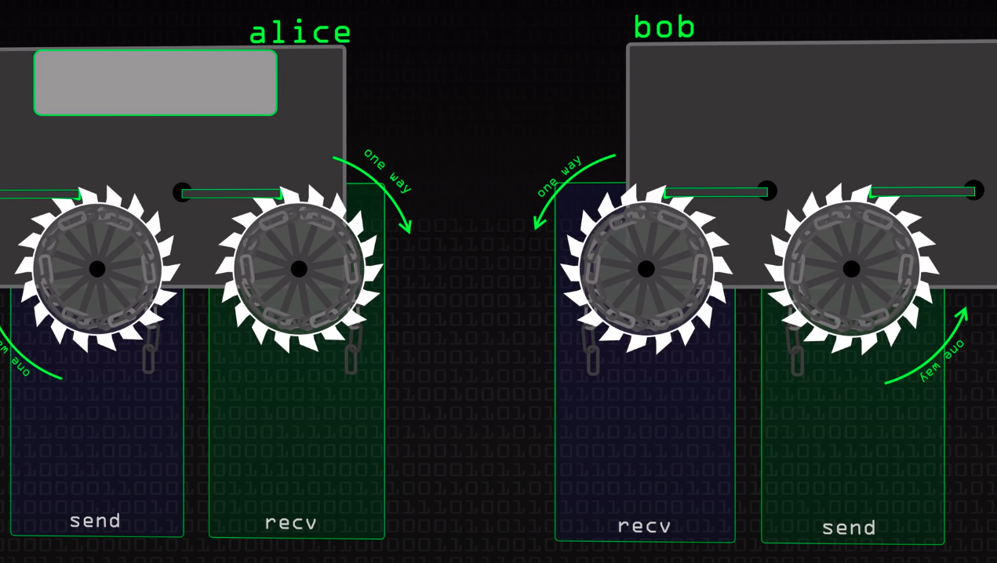
The other two ratchets are the sending and receiving ratchets. Alice’s sending ratchet’s state must always match Bob’s receiving ratchet state, and vice-versa
We have only one secret key but we need to initialize two ratchets right,
How

Slide 21
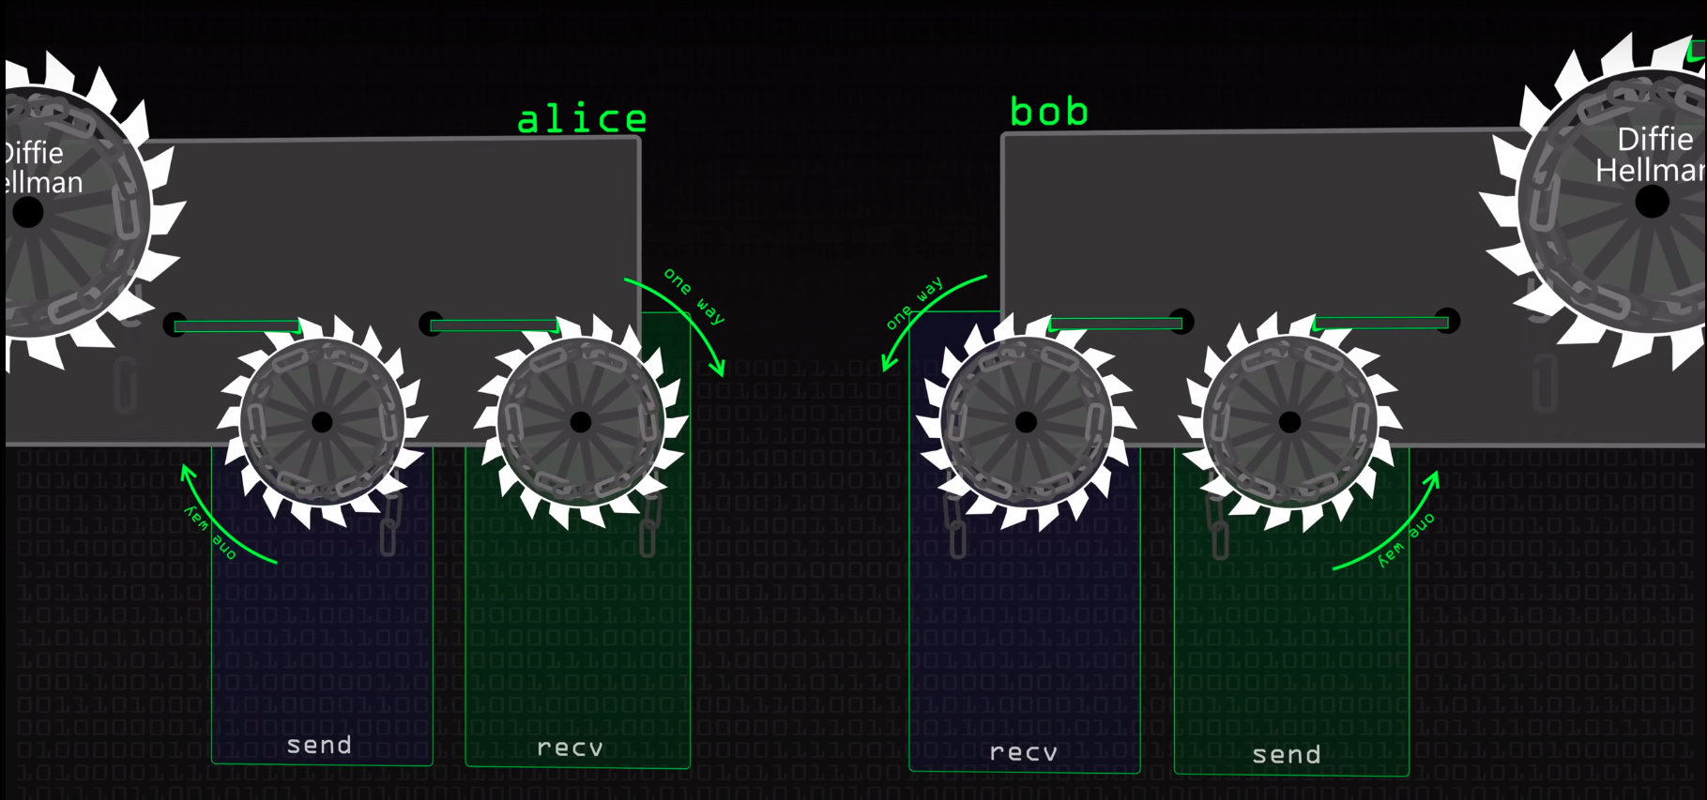
Root Ratchet
Root ratchet will initialized using the secret key .Recv and Send two ratchets are both initialized from the first two keys provided by the root chain. When Alice wants to send a message to Bob, she turns her sending ratchet once, obtaining a new message key. She then encrypts her message using that message key.

Slide 22
Double Ratchet Most 2 Applications
1.Forward Secrecy
Achieved (only one way , like hash function)
Input -----function---- Output
Output----function----Input
2.Break-In-Recovery
What if
send_ratchet or
recv_ratchet or
root_ratchet state
is known to the attacker ...

Slide 23

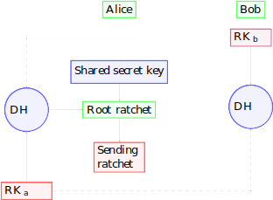
recv and send ratchets by turning the root ratchet.
Diffie-Hellman Ratchet

Slide 24
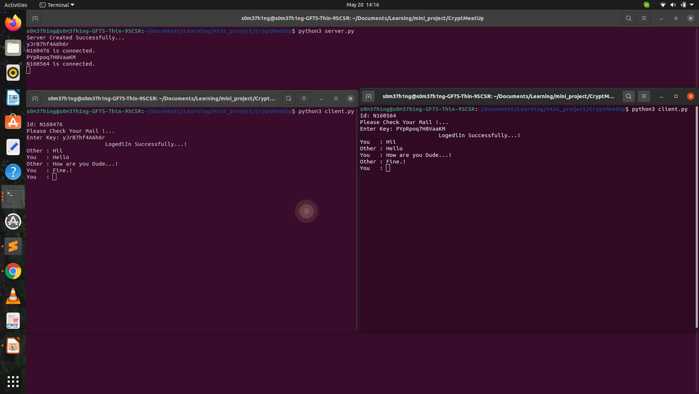

Slide 25
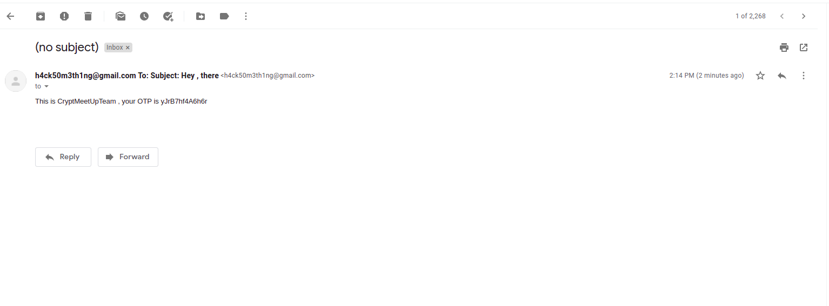

Slide 26
Secret will always a secret when you use crypt tools.

Slide 27
recv and send ratchets by turning the root ratchet.
Diffie-Hellman Ratchet

